Slide 1
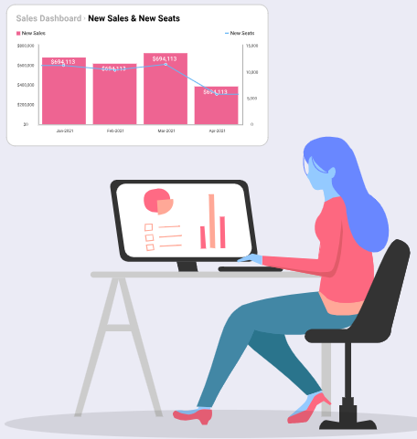
Self-service Business Intelligence (BI)
Self-service Business Intelligence (BI) is a modern approach to data analysis that enables business users, such as marketing managers, sales professionals, and operations analysts, to independently access and analyze data without requiring help from IT teams or data specialists

Slide 2
Self-service Business Intelligence (BI)
With tools like
Power BI,
Tableau, users can interact with data through intuitive dashboards, drag-and-drop functionality, and natural language queries.

Slide 3
Example
A marketing manager can use self-service BI to evaluate campaign performance by pulling data from platforms like Google Analytics or social media metrics and creating custom visualizations, such as charts showing the click-through rate (CTR) or conversion trends over time.

Slide 4
Self-service BI (Power BI)
In Power BI, self-service BI functions are those that empower non-technical users to independently interact with and analyze data through intuitive, user-friendly tools.

Slide 5
Data Connectivity and Loading
Connecting to common data sources like Excel, CSV files, SharePoint, SQL Server, or online services like Google Analytics and Salesforce.
Importing and loading data into Power BI for analysis.

Slide 6
Data Transformation with Power Query
Using the Power Query Editor for basic data cleaning and transformation, such as:
Renaming columns and tables.
Removing duplicates and null values.
Splitting or merging columns.
Filtering rows or sorting data.
Applying straightforward transformations using the GUI (e.g., changing data types, grouping data, or creating calculated columns).

Slide 7
Data Visualization
Dragging and dropping fields to create charts, graphs, and tables.
Building interactive dashboards and reports with slicers, filters, and visuals like bar charts, pie charts, line graphs, and maps.
Customizing visuals by modifying colors, labels, and layouts.

Slide 8
Basic Analytics and Calculations
Creating simple measures and calculated columns using DAX (e.g., SUM, AVERAGE, COUNT).
Using built-in analytical tools like "Quick Measures" to calculate ratios, year-to-date, or running totals.
Adding trend lines and data labels to visuals.

Slide 9
Interactivity and Filtering
Setting up slicers, filters, and drill-through features to explore data interactively.
Configuring report-level, page-level, and visual-level filters.

Slide 10
Collaboration and Sharing
Publishing reports to the Power BI Service for sharing with team members.
Creating shared dashboards to provide an overview of key metrics.
Exporting reports to formats like PDF or PowerPoint.

Slide 11
Using Power BI Templates
Starting with pre-built templates or importing report templates shared across the organization.
Modifying templates to align with specific business needs

Slide 12
Continue…
In Power BI, certain functions and tasks are not considered self-service BI because they typically require advanced technical expertise, administrative access, or involvement from IT or data professionals
Data Modeling and Complex Transformations
Data Integration and Preparation
Data Governance and Security
Advanced Analytics and AI

